Slide 1


PANIMALAR INSTITUTE OF TECHNOLOGY
DEPARTMENT OF COMPUTER SCIENCE AND ENGINEERING
ANNA UNIVERSITY :: CHENNAI -600 025
PRICE NEGOTIATING E-COMMERCE CHAT BOT SYSTEM USING AI AND DEEP LEARNING
Final Project Review
DATE-29/07/2021 BATCH NO – B17
GUIDED BY: Mrs. D.Lakshmi , M.E, (Ph.D)
Associate professor/CSE
MEMBERS: Pradeep Kumar Ramesh (211517104123)
Hemakumar A.V (211517104058)
Manoj Kumar S (211517104097)

Slide 2
BONAFIDE CERTIFICATE
Certified that this project report “PRICE NEGOTIATING E-COMMERCE CHAT-BOT SYSTEM USING ARTIFICIAL INTELLIGENCE AND DEEP LEARNING” is the bonafide work of “PRADEEP KUMAR RAMESH (211517104123), HEMA KUMAR A V (211517104058) and MANOJ KUMAR S (211517104097)” who carried out the project work under my supervision.
SIGNATURE SIGNATURE
Dr. V. SUBEDHA, M.Tech, Ph.D
Professor and Head,
Department of CSE,
Panimalar Institute of Technology,
Poonamallee, Chennai – 600 123.
Mrs. D.Lakshmi, M.E, (Ph.D)
Associate Professor,
Department of CSE,
Panimalar Institute of Technology,
Poonamallee, Chennai – 600 123.

Slide 3
AGENDA
ABSTRACT
Modules and their Description
Existing System & Proposed System
LIMITATION OF EXISTING SYSTEM
PROPOSED SYSTEM
Project Life cycle Details
USE CASE DIAGRAM ADMIN
PROJECT IMPLEMENTATION
TECHNOLOGIES USED
ADVANTAGES OF PROJECT
DISADVANTAGES OF PROJECT
FEATURES
CONCLUSION
REFERENCES

Slide 4
ABSTRACT
INTRODUCTION:
AI based automated negotiation can give a flexible price instead of a fixed price in e-commerce, and can maximize the pay-offs of both buyer and seller.
It can be seen as an ideal and efficient mechanism for business. There are three main approaches for automated negotiation: the decision theory, the game theory and the negotiation analysis. Then, give a view of some famous models.
Finally, we point out that the automated negotiation is still in its infant stage, because there are still some difficulties in this field. The first is the ontology issue, the second is agents' strategies and third is Communication protocol. Decision analysis and especially multi attributive utility theory play an important role for the support of electronic negotiations.
The preferences are usually represented as a utility function on the set of alternatives such that the user prefers an alternative exactly when it has higher utility. Successful experience of the human traditional negotiation is the valuable learning resources of automatic negotiation. Automated negotiation model can learn from experience in negotiation, reason, and give a reasonable choice of negotiations on a new strategy.

Slide 5
Modules and their Description
The system comprises of 2 major modules with their sub-modules as follows:
Admin
Login: Admin need to login by providing the login credentials to access the below given admin modules.
Add / View Product: Admin can enter details about new products details and view its details.
View Order: Admin can view details about the order placed by the user.
View Users Details: Admin can view all the registered user’s details.
User
Login/Registration: User can register on the system and get his online account on site.
Chat Bot: Automated negotiation model can learn from experience in negotiation, reason, and give a reasonable choice of negotiations on a new strategy. User can chat with the bot for price negotiation for a particular product.
Add to Cart: Users can add multiple products to cart.
Pay using Card: After total bill is calculated user can pay via credit card online.
View Order: User can view details about the order placed.

Slide 6
Existing System & Proposed System
Problem with current scenario
In existing system, shopping has done in a manual way, the customer has to go for shopping, and then he is having the possibility to choose the products whatever customer wants.
Product’s in the store are normally arranged by their types and price.
Customers chooses from the collection of Cloths, where the items are labelled by their price and occasionally, the discounts offered on the particular item. Sales staff are always there in case the customers want some assistance.
The customer takes the items he chooses by their requirements or interests and takes the items to the billing section.
The bill is collected in the form of cash or credit card and a memo is prepared for the sold items which contains the information about the product such as price and quantity.
It is a time consuming process.
Thus, the system has to be automated.

Slide 7
LIMITATION IN EXISTING SYSTEM
In Existing System, the Customer is completely depending on the manual process for buying the product.
Manual process is a time consuming factor and when customer approaches for a manual shopping directly, actually he/she does not have an idea about things like, price range, etc….
While online payment using card, the card details are stored as it is into the database without any encryption.
There is a possibility of card details getting hacked.
The time which has been spent by the customer in manual shopping can equates to multiple number of shopping. As customer can sit at home and browse in a fraction of seconds.
The system is limited to a particular area as the store generally caters the need of people living in a particular territory.
Customers have to take pain to go to the shop in case of heat, cold, rain etc.
No common platform and easy facility normally available where many dealers can interact with one as many stores have products of just one particular company or dealer.
Thus, we need to change to a system like “Online Shopping”.

Slide 8
PROPOSED SYSTEM
Considering the anomalies in the existing system computerization of the whole activity is being suggested after initial analysis.
The web application is developed using Visual Studio with Asp .Net with C# as a programming language.
Proposed system is accessed by two entities namely, Admin and User.
Admin need to login with their valid login credentials first in order to access the android application.
After successful login, admin can access all the modules and perform/manage each task accurately.
Admin can perform task such as adding new product with its details and viewing added product details, viewing order details and user details.
User need to register using basic registration details and need to create valid login id and password.
User can login using valid login credentials in order to access the system.
User can view products and chat with the AI bot for price negotiation for a particular product.
After negotiation, user can buy the product from the website and pay.

Slide 9
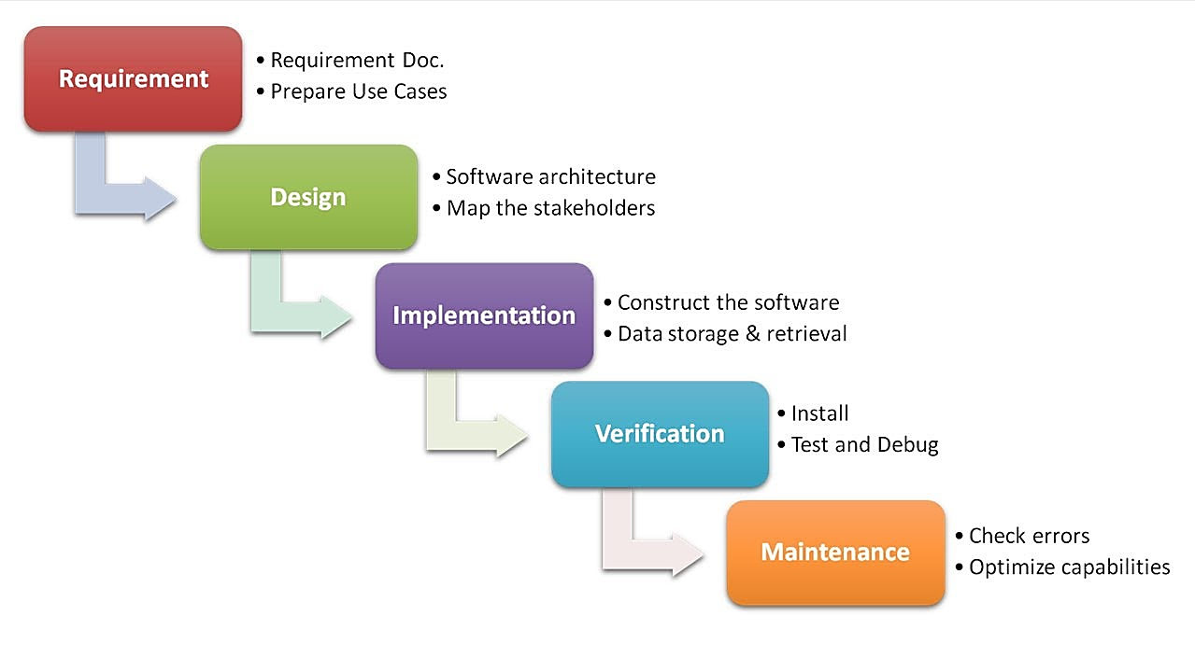
Project Life cycle Details
Waterfall Model

Slide 10
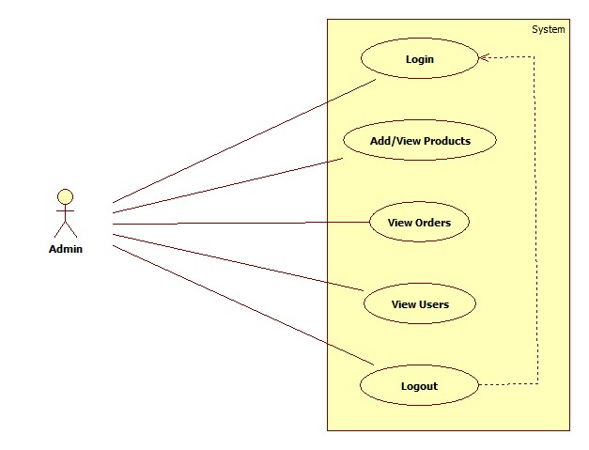
USE CASE DIAGRAM ADMIN

Slide 11
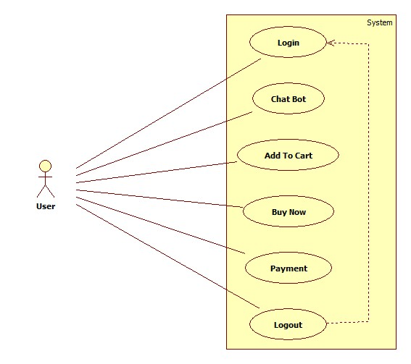
Use Case Diagram of User

Slide 12
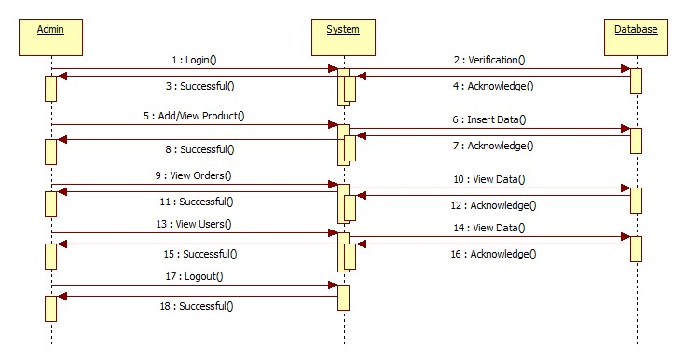
Sequence Diagram of Admin

Slide 13
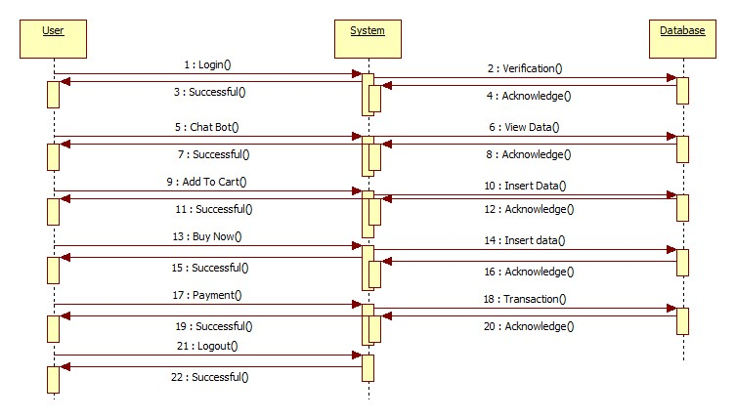
Sequence Diagram of User

Slide 14
PROJECT IMPLEMENTATION
Project Implementation Technology
The Project is loaded in Visual Studio 2020. We used Visual Studio for Design and coding of project. Created and maintained all databases into SQL Server 2020, in that we create tables, write query for store data or record of project.

Slide 15
TECHNOLOGIES USED
Front End Technology
Microsoft .NET Framework
Console applications.
Scripted or hosted applications.
Windows GUI applications (Windows Forms).
ASP.NET applications.
XML Web services.
Windows services.

Slide 16
TECHNOLOGIES USED
BACK END TECHNOLOGY
Microsoft SQL Server
Relational Database
Client/Server:
Structured Query Language (SQL)

Slide 17
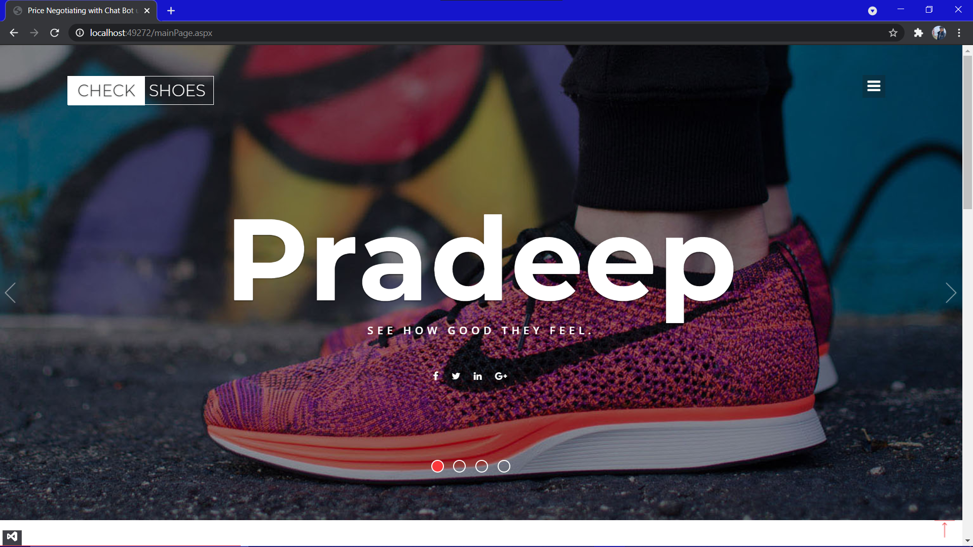
IMPLEMENTATION RESULT

Slide 18
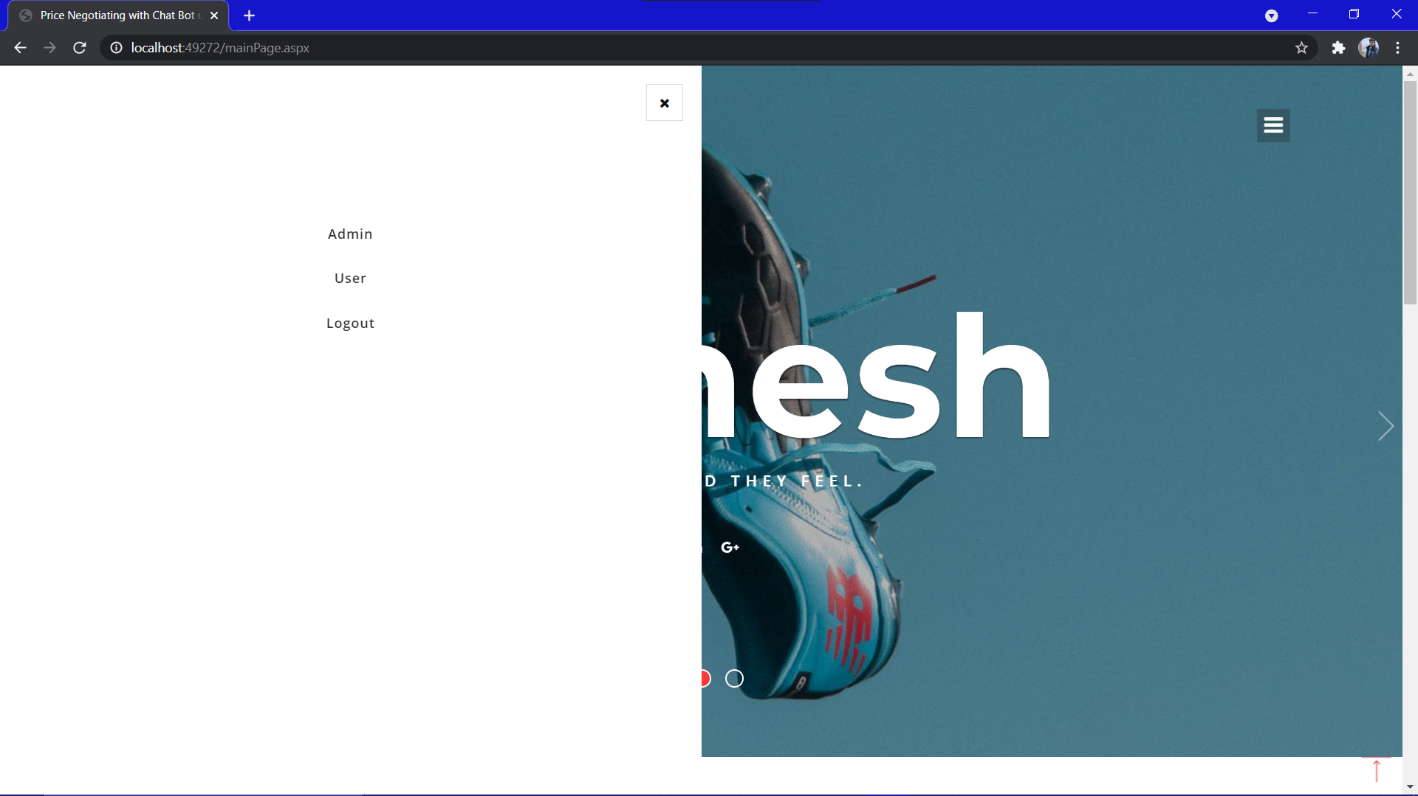
MAIN PAGE SIDEBAR

Slide 19
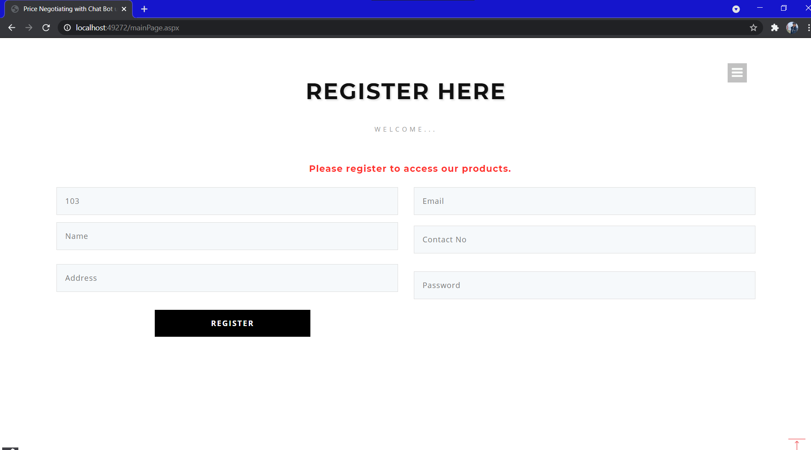
REGISTRATION PAGE

Slide 20
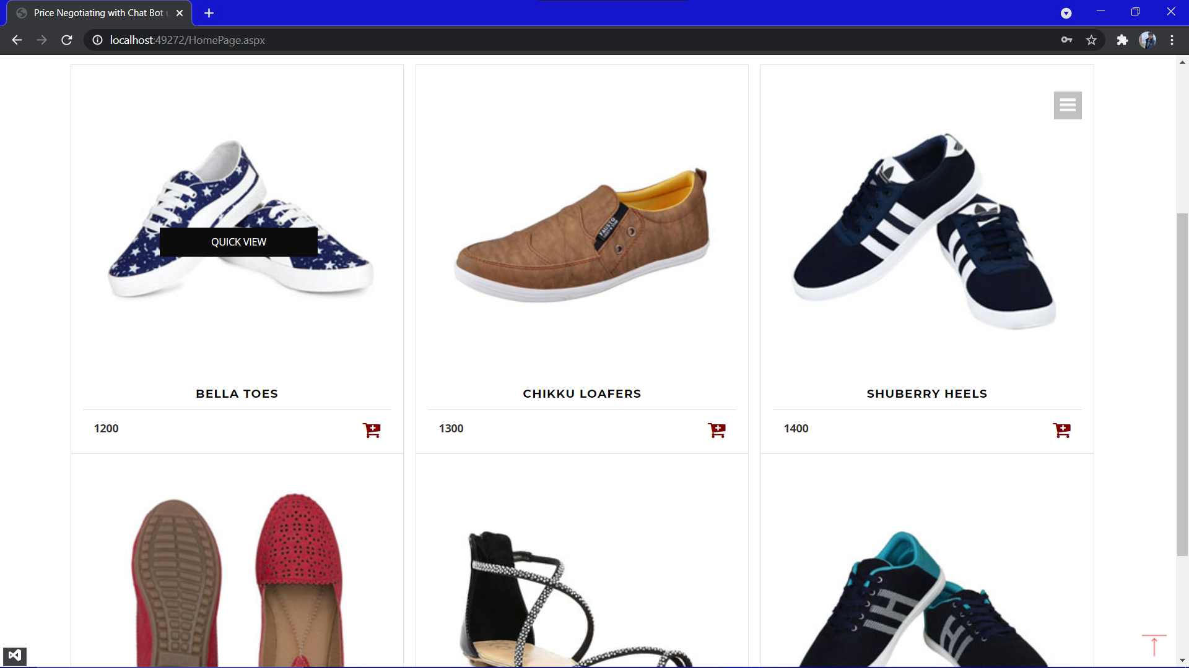
CATALOGUE PAGE

Slide 21
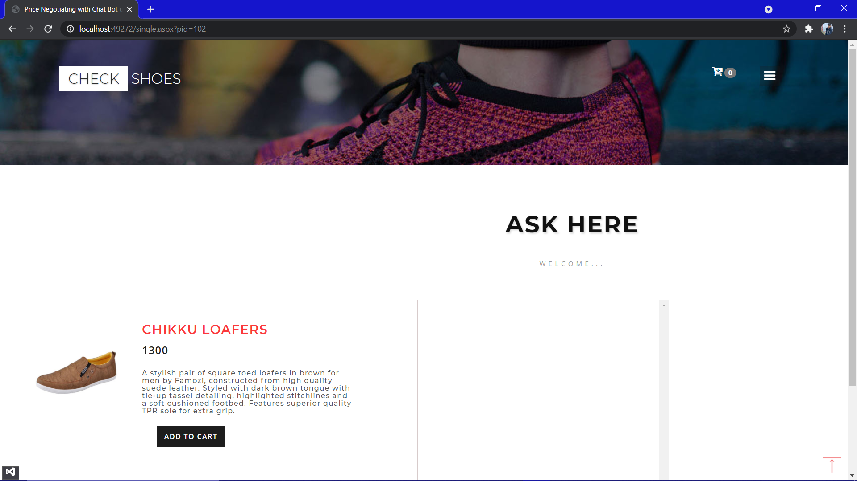
ITEM PAGE

Slide 22
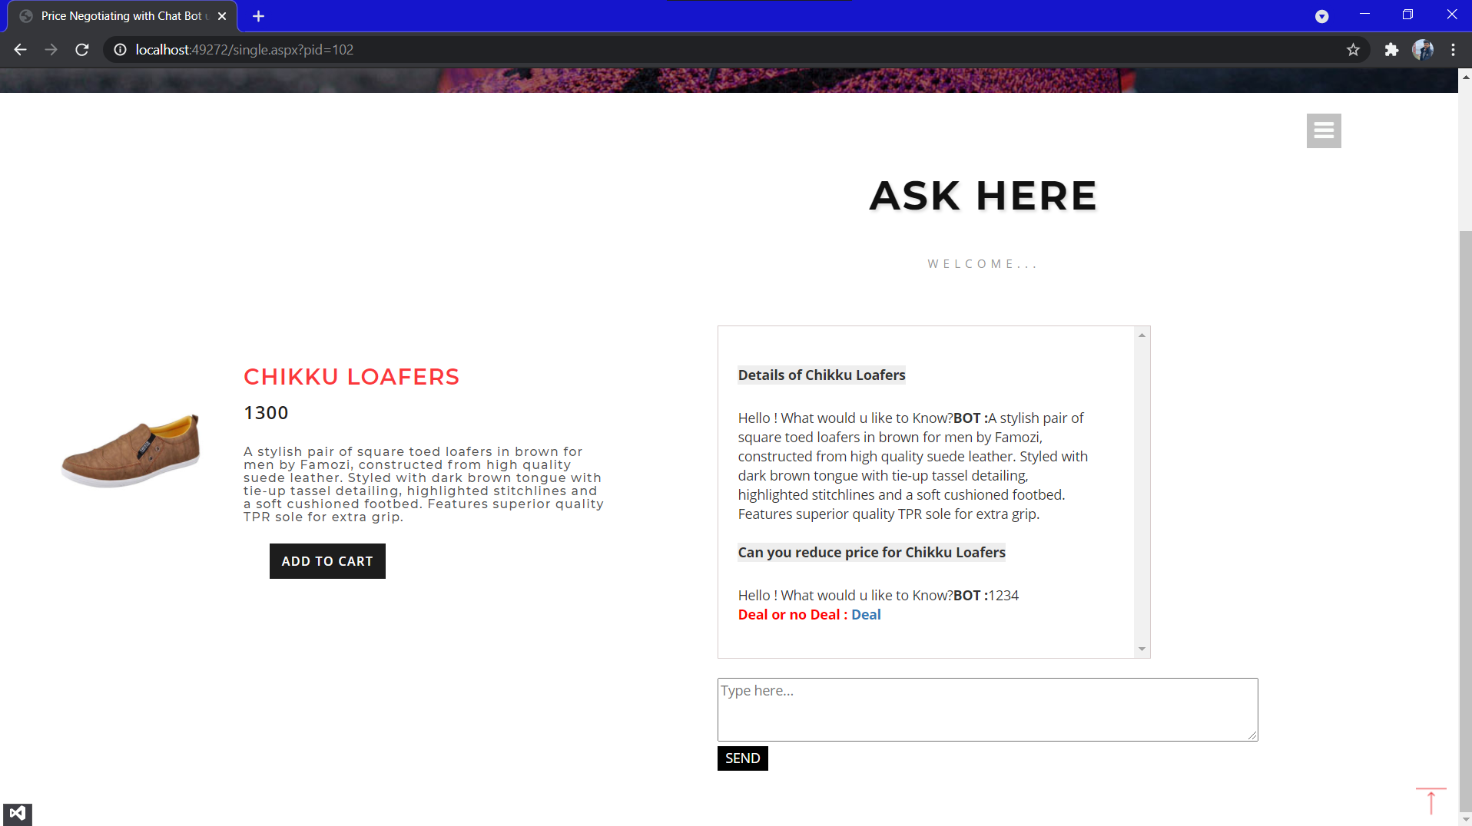
User Reply

Slide 23
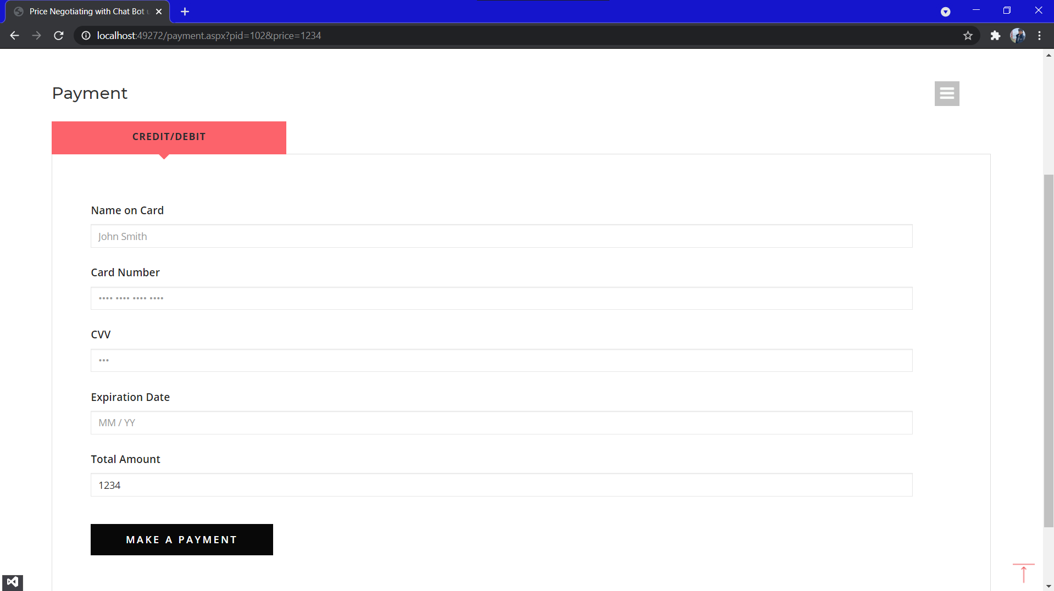
PAYMENT PAGE

Slide 24
ADMIN- USER INTERACTION

Slide 25
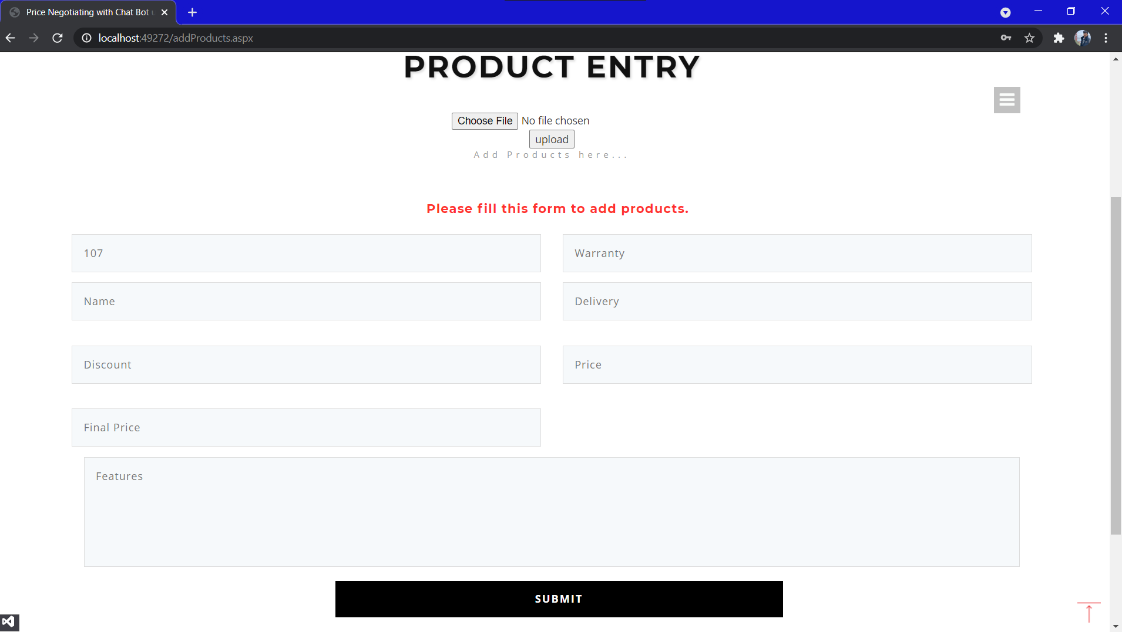
Product Entry

Slide 26
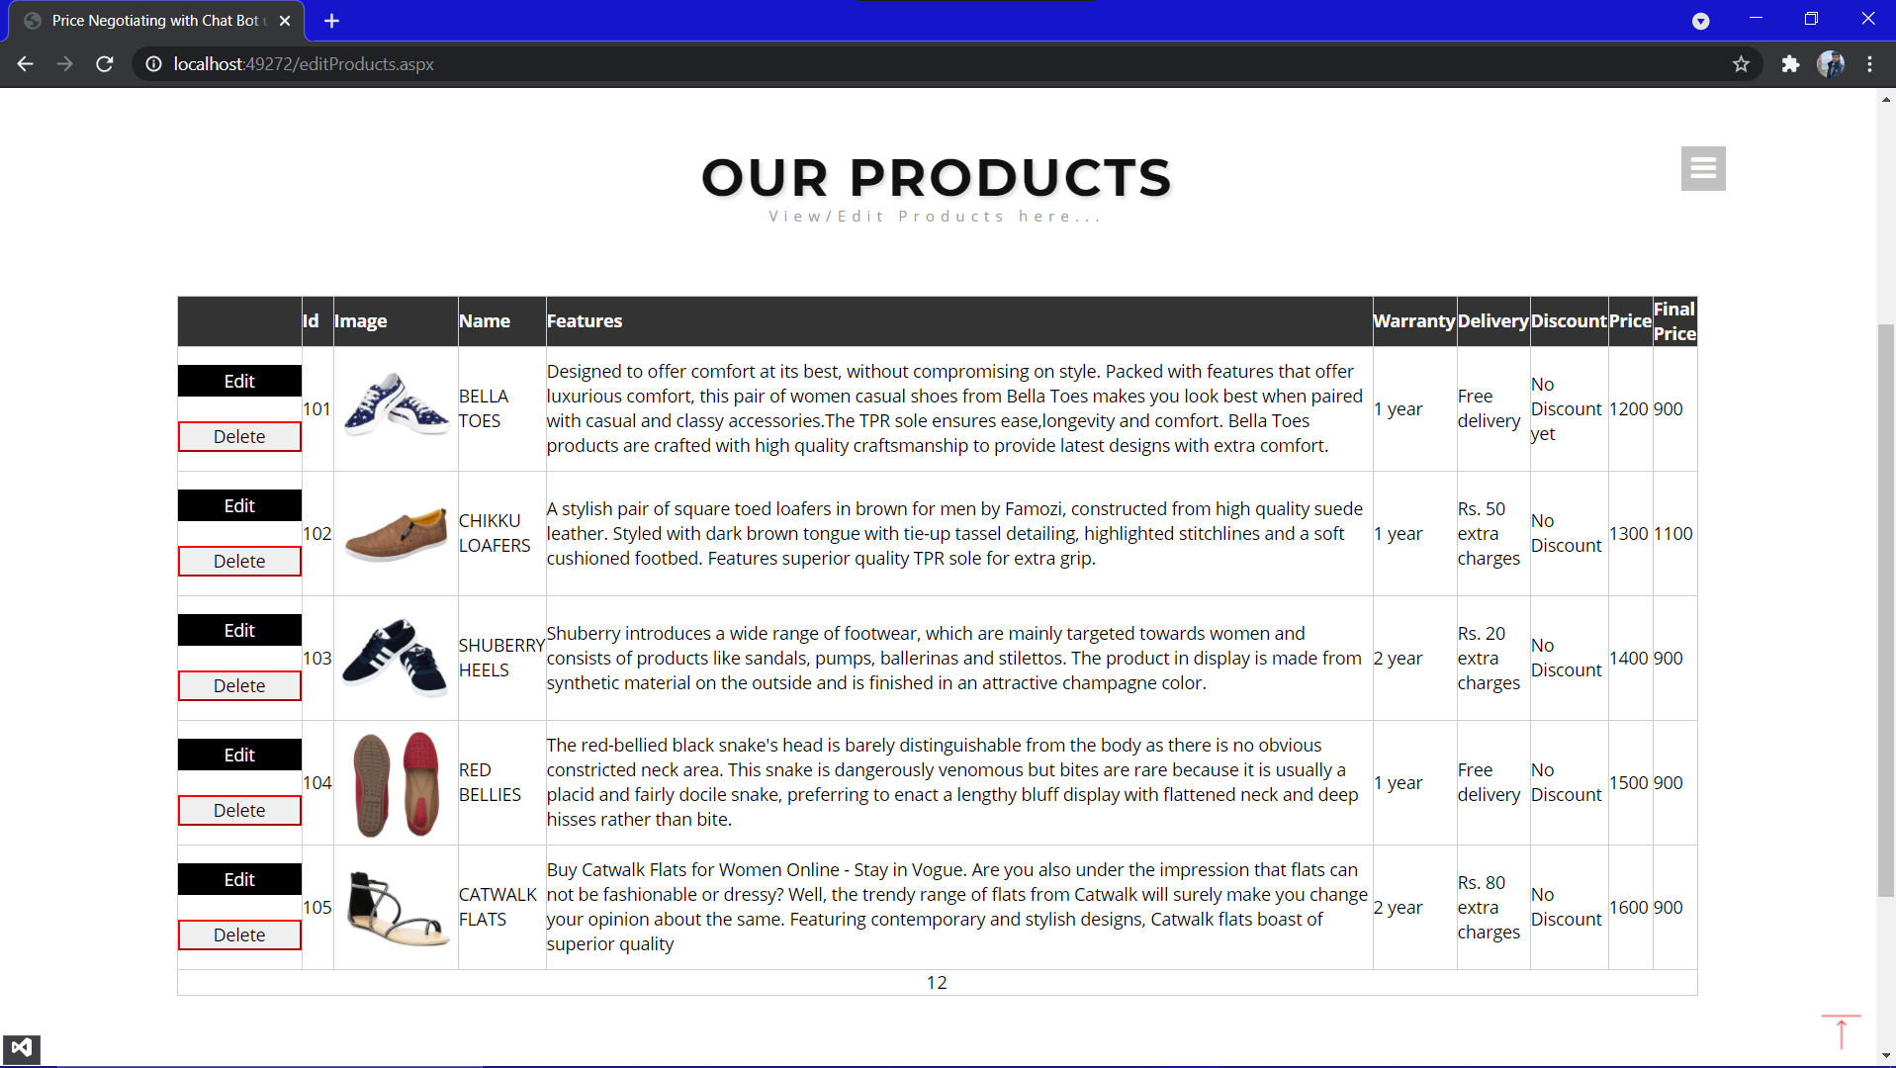
Product Database

Slide 27
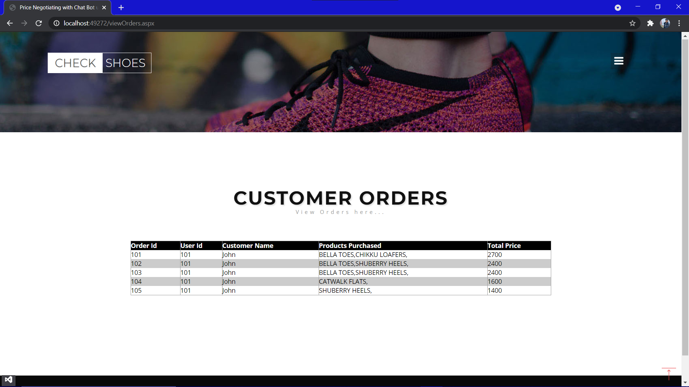
CUSTOMER ORDER

Slide 28
ADVANTAGES OF PROJECT
Helps shops to automate selling online.
Consumers can negotiate with the AI Bot with respect to product price.
After price negotiation, payment link with negotiated price is sent over mail to consumer.
Recovers abandoned cart.
Reduces the number of abandoned cart.
Helps shops to take cc payments.
Provides email confirmation on payment success.

Slide 29
DISADVANTAGES
It requires active internet connection else, error may occur.
Does not keep track of stock.
Application
This system can be used in single shop.
This system can be used to sell like chain of furniture shops from a single site.

Slide 30
FEATURES
Load Balancing:
Since the system will be available only the admin logs in the amount of load on server will be limited to time period of admin access.
Easy Accessibility:
Records can be easily accessed and store and other information respectively.
User Friendly:
The website will be giving a very user-friendly approach for all user.
Efficient and reliable:
Maintaining the all secured and database on the server which will be accessible according the user requirement without any maintenance cost will be a very efficient as compared to storing all the customer data on the spreadsheet or in physically in the record books.
Easy maintenance:
Price Negotiating with Chat Bot website is design as easy way. So maintenance is also easy.

Slide 31
CONCLUSION
This was our project of System Design about “Price Negotiating with Chat Bot” is a web application based on Asp .Net language. The Development of this system takes a lot of efforts from us. We think this system gave a lot of satisfaction to all of us. Though every task is never said to be perfect in this development field even more improvement may be possible in this application. We learned so many things and gained a lot of knowledge about development field. We hope this will prove fruitful to us.

Slide 32
REFERENCES
Websites:
en.wikipedia.org
Microsoft Developer Network (MSDN): http://msdn2.microsoft.com/en-us/default.aspx: This is a valuable online resource, and is a must for any developer using Microsoft tools.
http://www.asp.net/: This is the official Microsoft ASP.NET web site. It has a lot of: tutorials, training videos, and sample projects.
http://ijcsit.com/docs/Volume%206/vol6issue02/ijcsit20150602125.pdf
https://www.brihaspatitech.com/blog/custom-shopify-app-chat-bot-powered-price-negotiator/
https://ecommerce-chatbots.com/

